Slide 1
Mini Project Employee Management System
Aryan Dubey – 6 / Seat No: IT4B078
Shubham Rawool – 40 / Seat No: IT4B117
Ashish Shingade – 52 / Seat No: IT4B129
Aaryan Swami – 56 / Seat No: IT4B133

Slide 2
PROBLEM STATEMENT
Employee Management System is a Desktop application, developed using Python and SQLite to maintain the details of employees working in any organization.
The EMS has been developed to override the problems prevailing in the practicing manual system.
The system works locally. It maintains the information about the personal and official details of the employees.

Slide 3
Objective of the project
This project aims to simplify the task of maintaining records of the employees of Company.
To develop an well-designed database to store employee information.
Provides full functional reports to management of Company.
The objective of this project is to provide a comprehensive approach towards the management of employee information.

Slide 4
Need of the project
Manual System
The records are maintained in registers.
Time consuming process.
Complicated searching, editing & updating.
Proposed System
Helps in maintaining the computerized employee details.
Create new Department, View Department in the system accordingly.
Create, View, Update, Delete, Search Employee records in the System.

Slide 5
Literature survey
References YouTube, Python Documentation, Various GitHub repositories, etc
https://www.ukessays.com/essays/information-technology/a-review-of-employee-management-systems-information-technology-essay.php

Slide 6
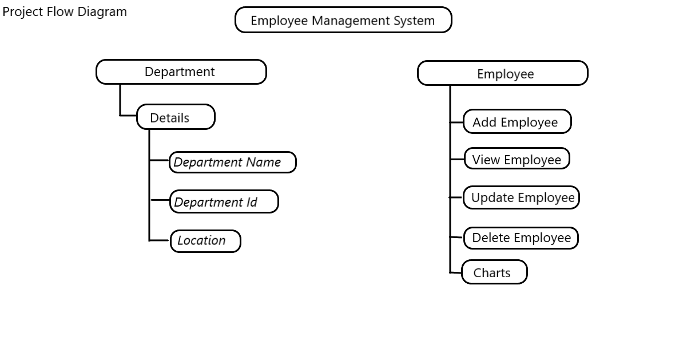
Project flow diagram

Slide 7
USAGE OF TECHNOLOGIES
Python Tkinter For GUI (FRONTEND).
Sqlite3 For Database (BACKEND).
Libraries used:
matplotlib library for plotting Graphs.
requests, bs4 for data scraping.
smtplib for automation.
datetime for Date and time.

Slide 8
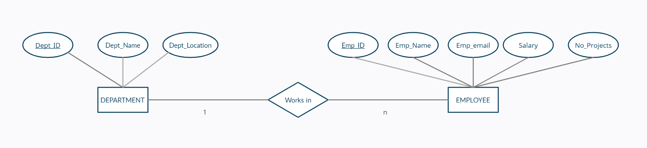
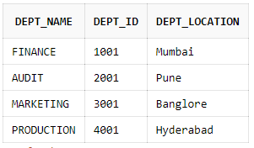
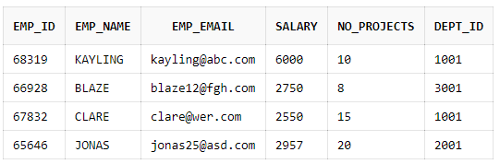
ER diagram and Tables

Slide 9
FEATURES AND FUNCTIONALITIES PROVIDED BY THE SYSTEM :
Our system has main interface of Admin Login which provides confidentiality of the system. Beyond this we have other interfaces which can be discussed as follows:
Main Page:
Admin can either choose to manage Department or Employees from this page.
Also the page shows the current location of Admin and its temperature.
Department:
Admin can create a new Department as per the company's requirements
Also admin can view Departments present in the company.

Slide 10
Employee:
Admin can add, view, update, delete and search Employee records from the database.
Analytics:
Admin can visualize total number of employees working in each department through a pie chart.
Admin can view Salary bar graph of all employees and compare them.
Admin can view the performance of all the Employees comparatively.
The Graph is plotted using the package matplotlib.pyplot by retrieving the data of Employees from the database.

Slide 11
AUTOMATION IN PROJECT:
Automated Email to the Employee:
An automated email is sent to the Employee on Addition of his records into the Database.
The Email ID of the Employee is retrieved from the database and the email is sent successfully which keeps the Employee up-to-date with his Records.
Location using API:
The current location of the admin is traced using his IP Address by the API "ipinfo.io"
Temperature using API:
The temperature of current location of admin is found using the API "api.openweathermap.org"
Quote of the Day using Data Extraction:
Quote of the Day is extracted from the website "brainyquote.com" using BeautifulSoup.
Reading new Quotes everyday will provide some motivation to the reader.

Slide 12
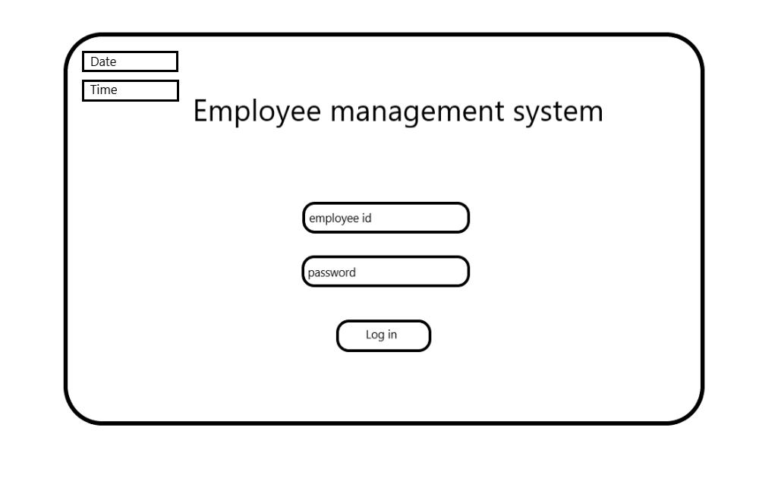
FRONTEND DESIGN

Slide 13
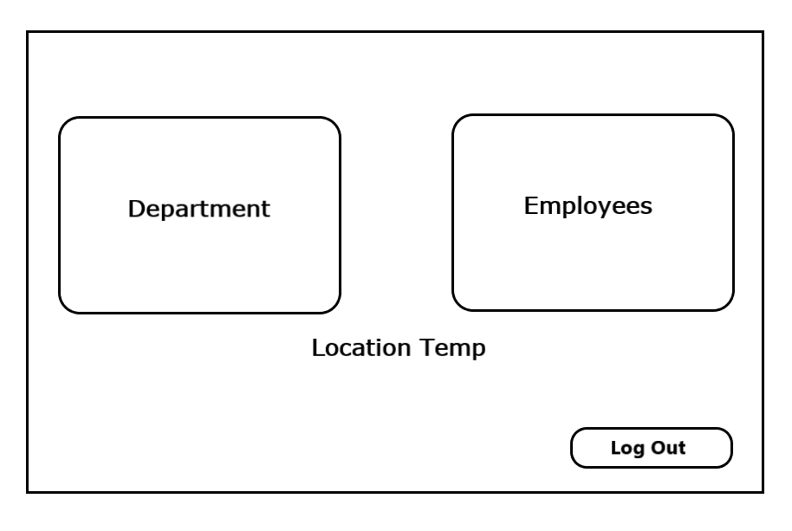

Slide 14
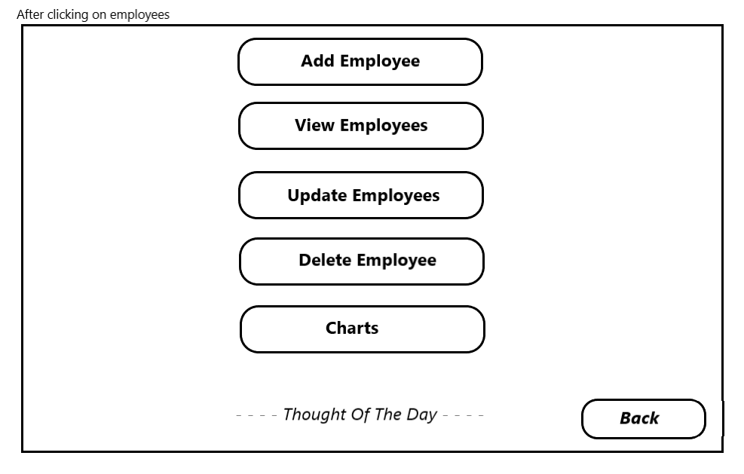

Slide 15
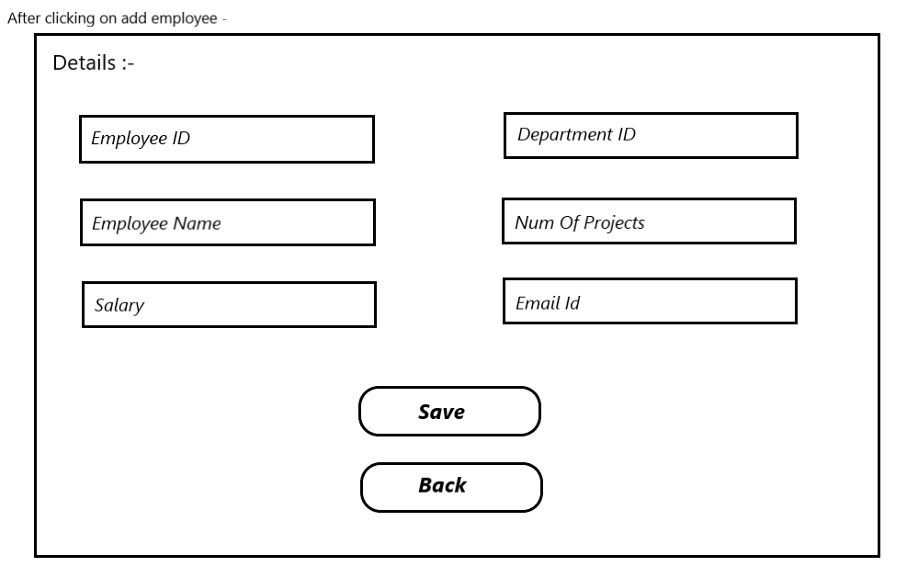

Slide 16
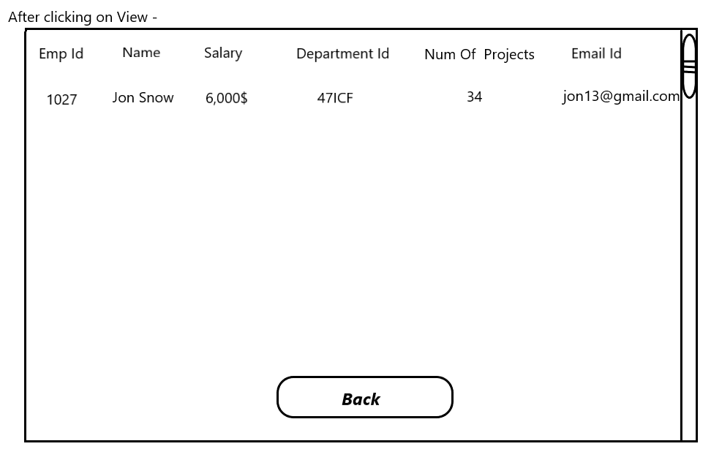

Slide 17
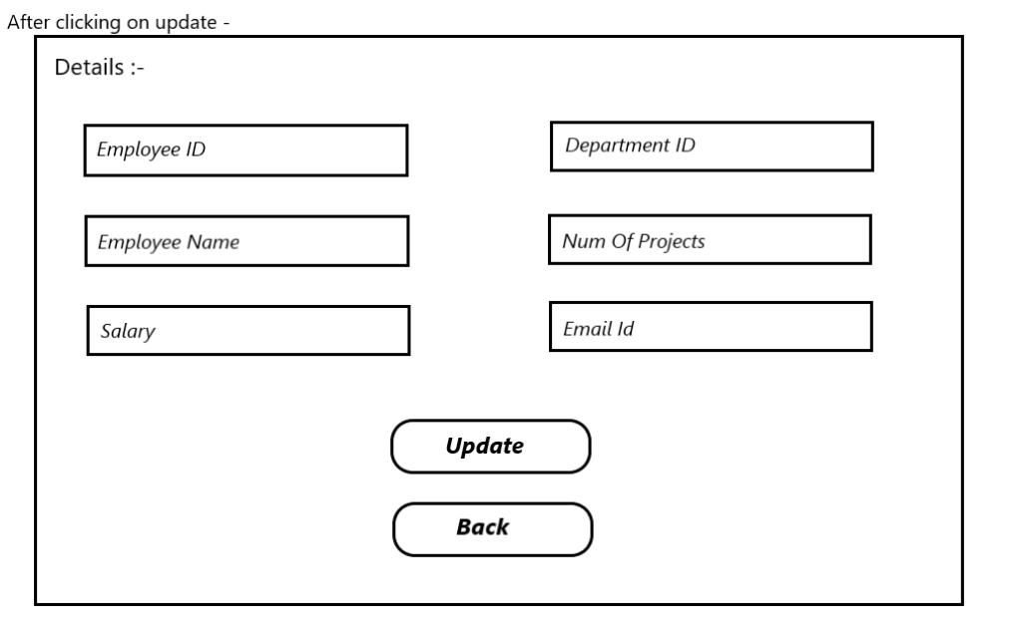

Slide 18
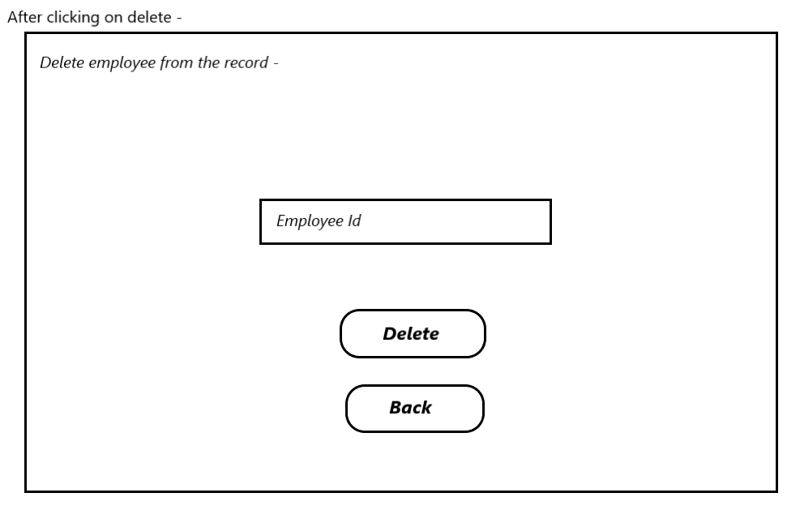

Slide 19
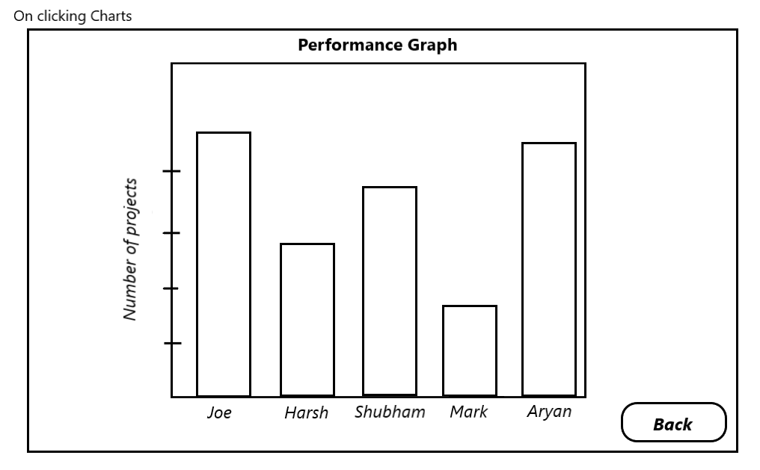

Slide 20
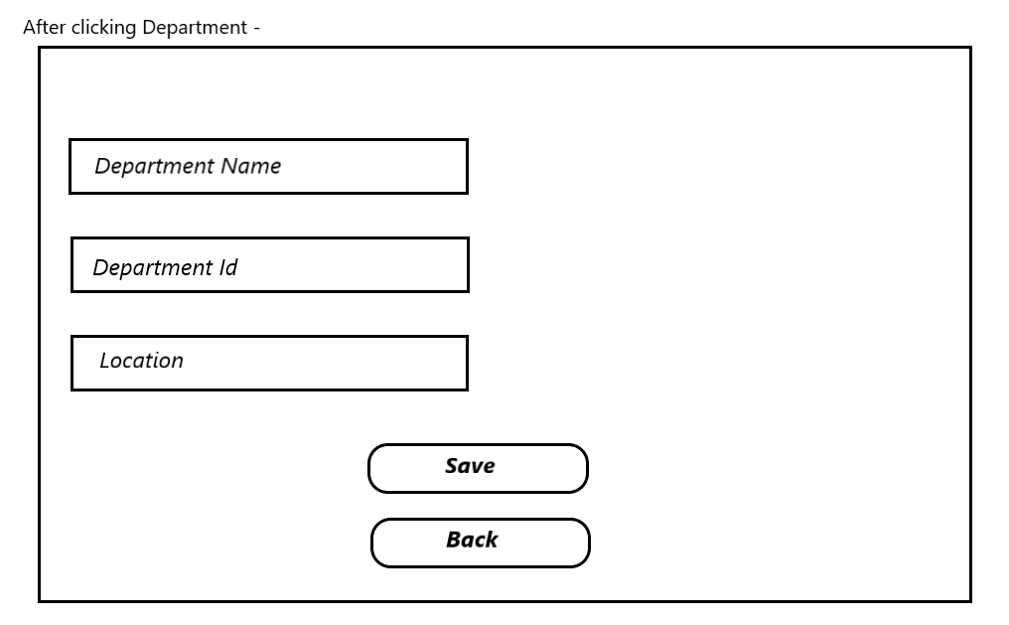

Slide 21
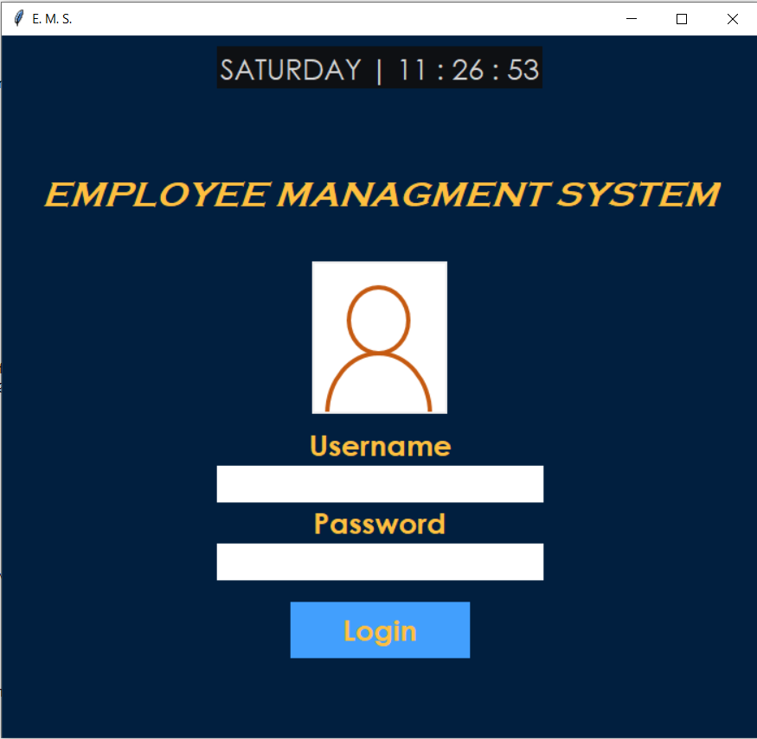
IMPLEMENTATION

Slide 22
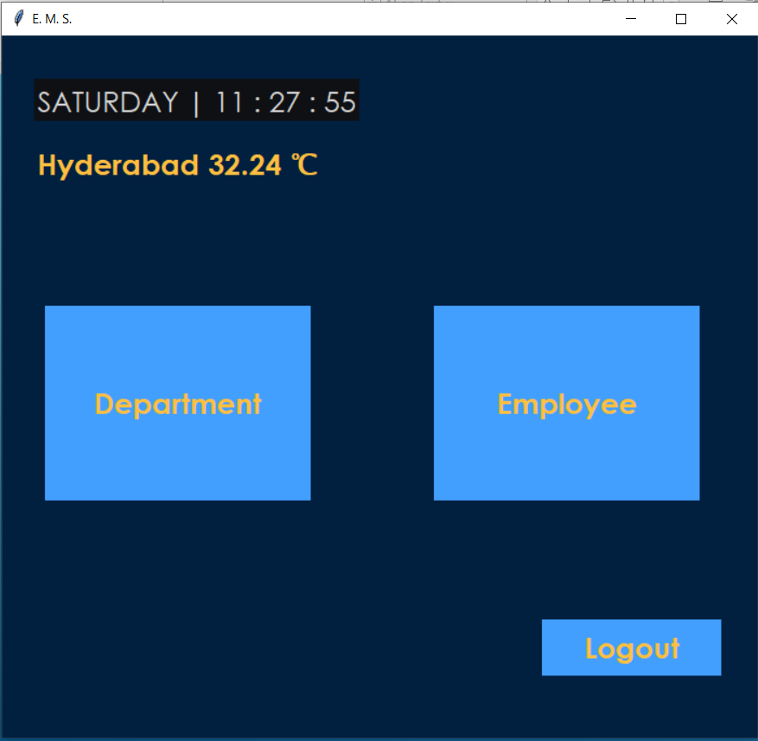
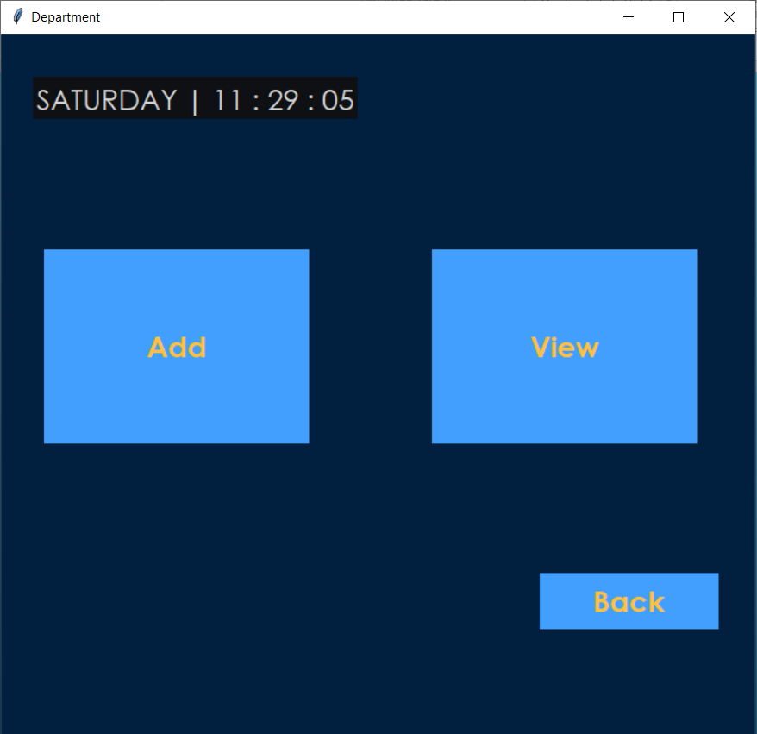

Slide 23
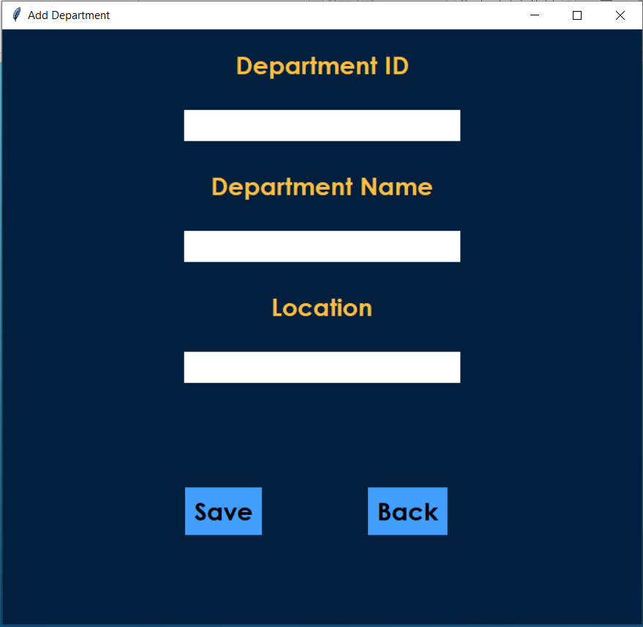
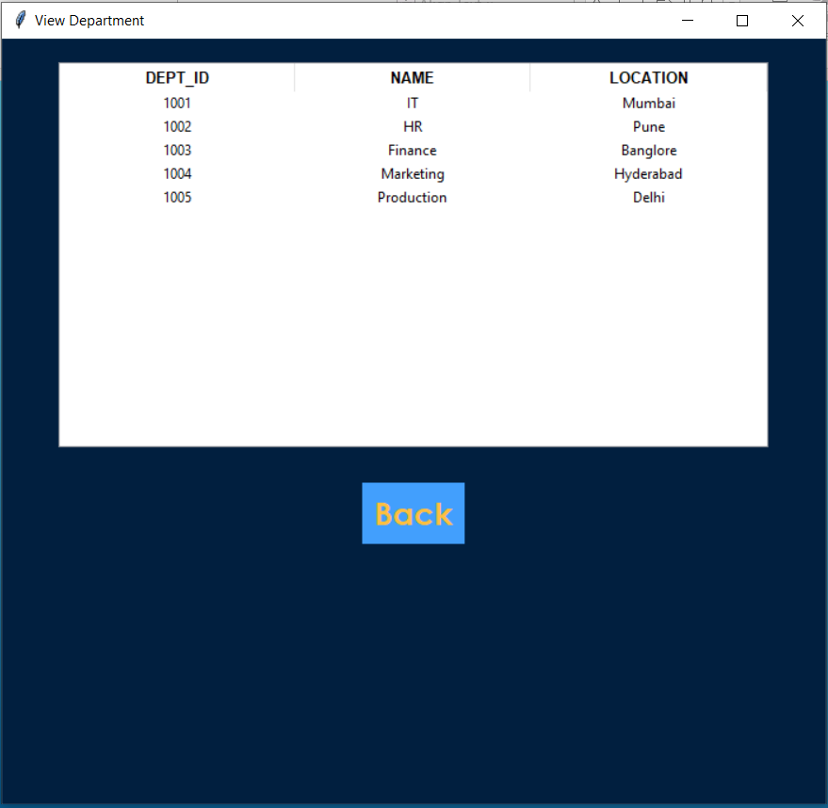

Slide 24
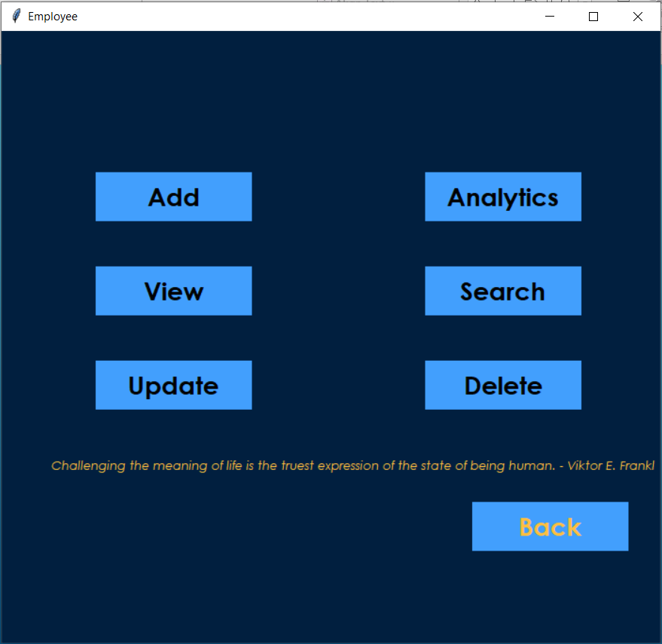
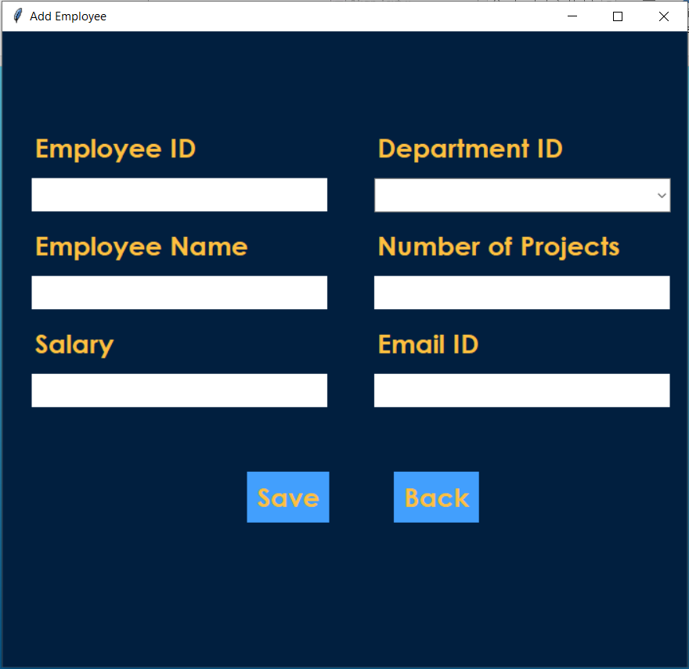

Slide 25
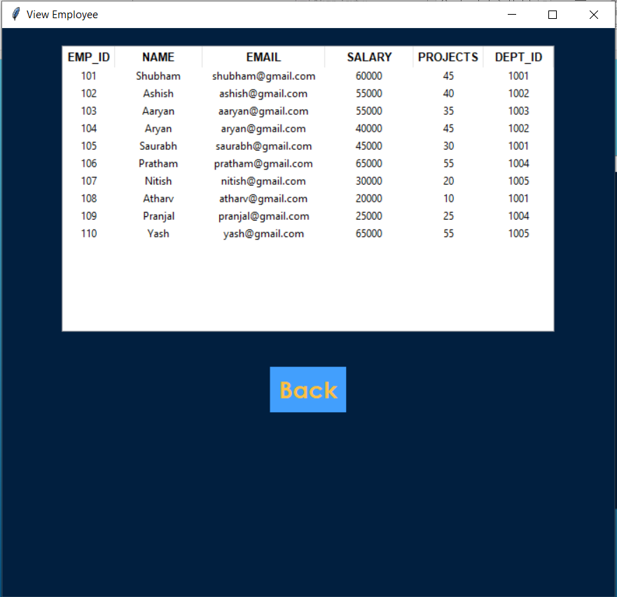
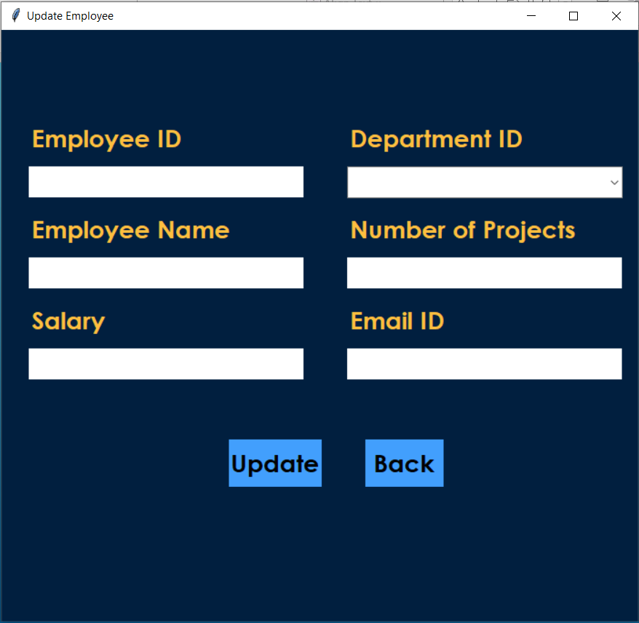

Slide 26
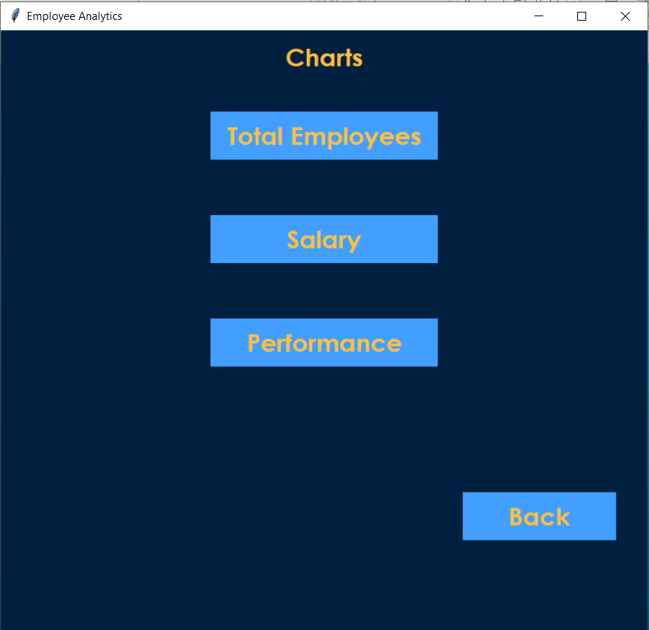
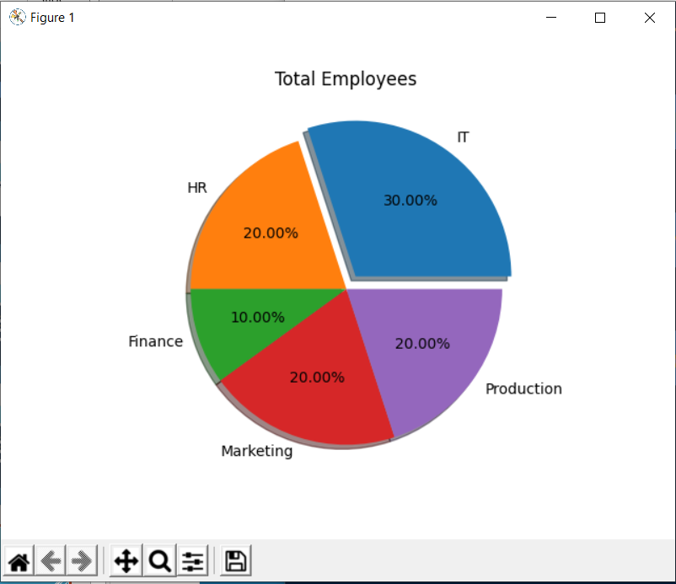

Slide 27
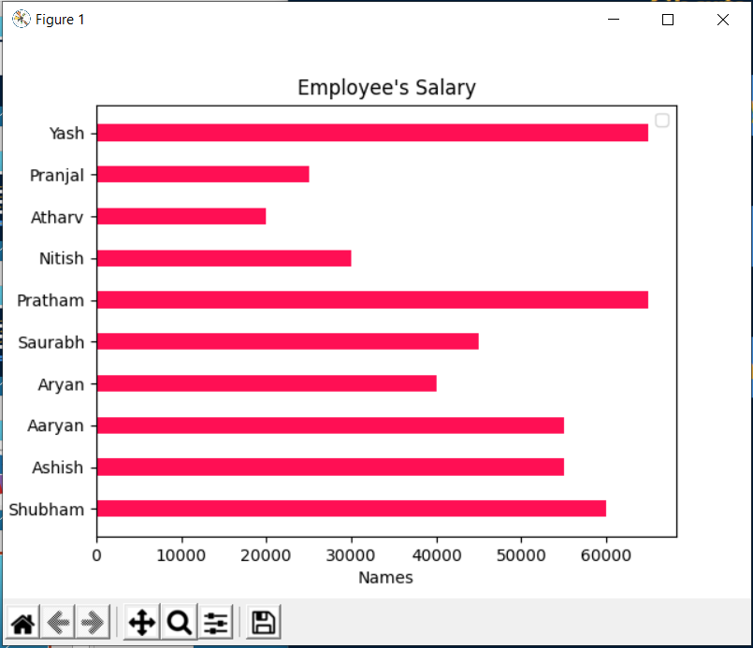
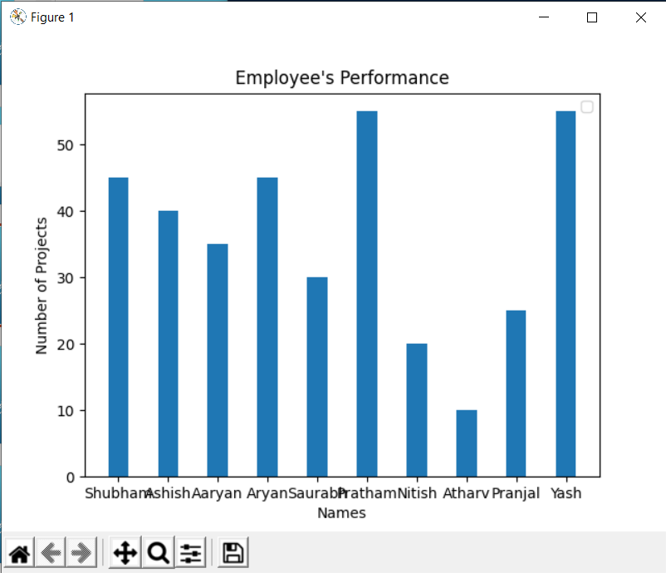

Slide 28
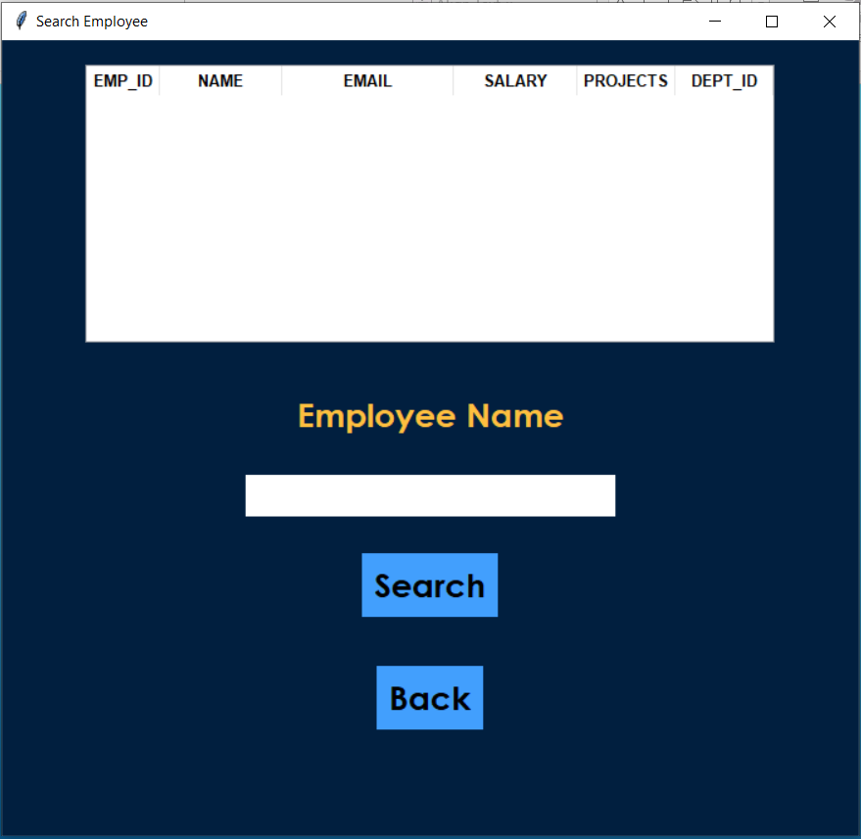
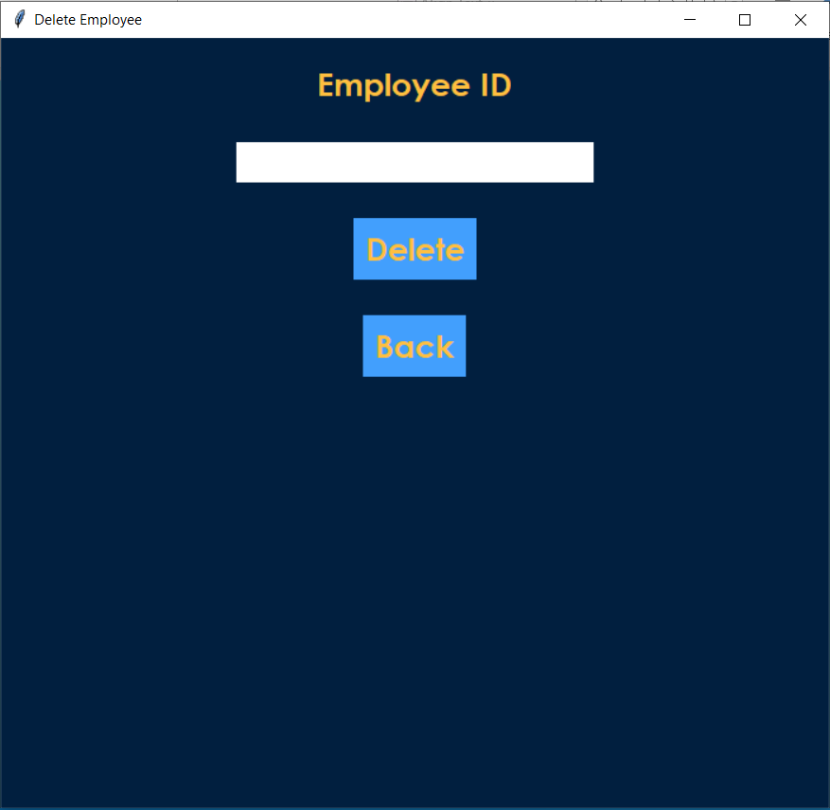

Slide 29
CONCLUSION
The project is to digitalize the database of Employees in Organizations and enabling Administrators to have benefit from Computers.
Software acts as a Information System between Employees and administrators. Here the user can keep his/her database secure and safe for a unlimited period of time.
Software provides Employee management System for Inserting, Updating, Searching and Deleting records with ease and simplicity.
Data can be analyzed for management purpose of the company.
We will provide a fresh new approach to our esteemed users to search for records and make databases in a digital way.

Slide 30
REFERENCES
YouTube, Python Documentation, Various GitHub repositories, etc
https://www.ukessays.com/essays/information-technology/a-review-of-employee-management-systems-information-technology-essay.php

Slide 31
THANK YOU !

